Slide 1
IMPLEMENTING CLOSEST PAIR OF POINTS IN COMPUTATIONAL GEOMETRY USING DIVIDE AND CONQUER ALGORITHM
Guided By : Prof. Ram Mohana Reddy Guddeti
Mentor : Dr. Revanesh M
Presented By:
222IT004 : Amrit Mohapatra
222IT008 : Tushar Choudhary
222IT023 : Neeraj Kumawat

Slide 2
INTRODUCTION
The Closest Pair of Points or Closest Pair problem is one of the fundamental problems in Computational Geometry: Given a set P of n ≥ 2 points , find the closest pair of P, i.e. two points p₀ ∈ P and p₁ ∈ P (p₀ = p₁) such that the distance between p₀ and p₁ is less than or equal to the distance of any distinct pair of points of P.
Some famous Problems in Computational geometry are Shortest Paths in the plane with polygonal obstacles, Closest pair of points, Convex Hull problem …
This paper implements distance between two closest pair of points in N - Dimensional Plane.

Slide 3
ALGORITHM PARADIGM:
DIVIDE AND CONQUER
A divide and conquer algorithm recursively breaks down the problem into two or more sub problems of same or related type until these become simple enough to solve directly. The solutions to the sub problems then combined to give a solution to the original problem.
Typically used with Recurrence relation solving and proving correctness

Slide 4
LITERATURE SURVEY
Computational geometry is a branch of computer science devoted to the study of algorithms which can be stated in terms of geometry. Some purely geometrical problems arise out of the study of computational geometric algorithms, and such problems are also considered to be part of computational geometry.
Computational complexity is central to computational geometry, with great practical significance if algorithms are used on very large datasets containing tens or hundreds of millions of points. For such sets, the difference between O(n²) and O(n log n) may be the difference between days and seconds of computation.

Slide 5
PROBLEM STATEMENT
Our job is to identify the two points with the least mutual distance among n points in d-dimensions.
Determining points a, b such that the interpoint distance (Euclidean) is the smallest possible pair of points given a set of n points.

Slide 6
OBJECTIVE
Design of Closest pair of points using divide and conquer algorithm for n points in 2 Dimensions.
Optimizing the algorithm to find the the closest pair of points in N dimensions.
Using the above algorithm to implement real-world applications such as delivery and air traffic control.

Slide 7
REAL LIFE EXAMPLES
Approach : Heuristic for Symmetric TSP - Nearest Neighbor
Example 1 : When delivering items to multiple locations, we use the closest nearest pair in the delivery system to speed up delivery in the two closest places.
Example 2 : In Air Traffic Control in order to reduce crashes between flights that may be seen when they are close to one another, warnings must be given.

Slide 8
MODULES
Brute Force
Approach for 2D and then for N-dimension
Applying principal component Analysis for N-dimensions to convert it into 2D for visualization of algorithm
Optimized Divide And Conquer Algorithm For 2D and then for N Dimensions
MODULE I
MODULE II
MODULE III

Slide 9
ALGORITHM (Divide-and-Conquer):
Divide: Divide the set S of n points by some point mid ∈ S into two sets S₁ and S₂ such that p < q for all p ∈ S₁ and q ∈ S₂ For example, mid ∈ S can be the median, found in O(n).
Conquer:
(a) finds the closest pair recursively on S₁ and S₂, gives us two closest pairs of points {p₁, p₂} ∈ S₁ and {q₁, q₂} ∈ S₂
(b) finds the closest crossing pair {p₃, q₃} with p₃ ∈ S₁ and q₃ ∈ S₂.
Combine: the closest pair in the set S is argmin{|p₁ − p₂|, |q₁ − q₂|, |p₃− q₃|}
Time Complexity is Θ(n logn)

Slide 10
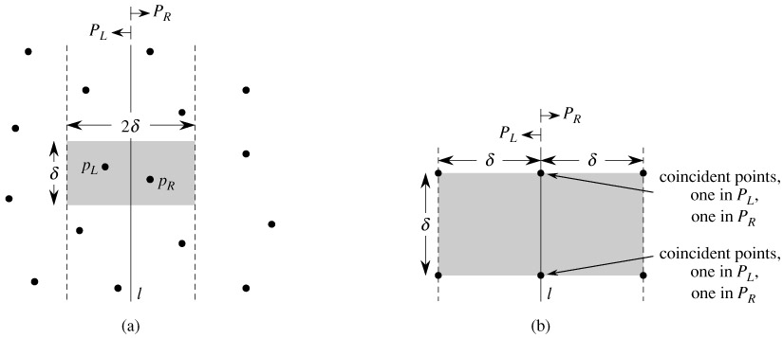
METHODOLOGY

Slide 11

VISUALIZATION

Slide 12
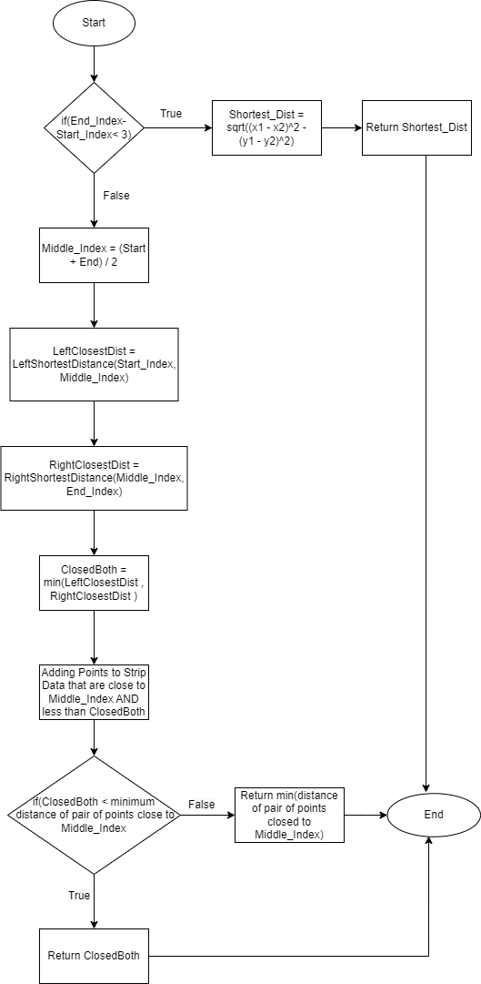
FLOW CHART

Slide 13
REFERENCES
Rau, M., Nipkow, T. (2020). Verification of Closest Pair of Points Algorithms. In: Peltier, N., Sofronie Stokkermans, V. (eds) Automated Reasoning. IJCAR 2020.Lecture Notes in Computer Science(), vol 12167. Springer,Cham.
Zhou, Y., Yu, H., 2015. An efficient comparison-based deterministic algorithm to solve the closest pair problem, 8th International Conference on Intelligent Computation
Bertot, Y.: Formal verification of a geometry algorithm: A quest for abstract views and symmetry in Coq proofs. In: Fischer, B., Uustalu, T. (eds.) Theoretical Aspects of Computing - ICTAC 2018. LNCS, vol. 11187, pp. 3–10. Springer (2018).
Zhou, Y., Xiong, P., Zhu, H., 1998. An improved algo rithm about the closest pair of points on plane set. Computer Research and Development 35, 957–960.
Bentley, J.L., Shamos, M.I., 1976. Divide-and-conquer in multidimensional space, in: Proceedings of the 8th Annual ACM Symposium on Theory of Computing, pp. 220–230.

Slide 14
Timeline
TASKS
AUGUST
SEPTEMBER
OCTOBER
NOVEMBER
DECEMBER
PROBLEM IDENTIFICATION
LITERATURE SURVEY
IMPLEMENTATION OF ALGORITHM
IMPLEMENTATION
OF BRUTE-FORCE ALGORITHM
IMPLEMENTATION OF DIViDE AND CONQUER ALGORITHM
COMPARISON AMONG ALGORITHMS
TESTING THE FINAL IMPLEMENTATION
REPORT MAKING

Slide 15
THANK YOU

